Slide 1
Creating Cloud Infrastructure with C# and Pulumi
Jake Adams

Slide 2
Outline
What
Why
How / Demos
Create cloud resources with Pulumi
Create dependent resources
Leverage strength of C# to create infrastructure
Stacks and configuration
Creating reusable building blocks (components and packages)
Importing manual or outside changes
Working with Pulumi infrastructure from other teams
Specialized setup (commands)
Multi-cloud

Slide 3
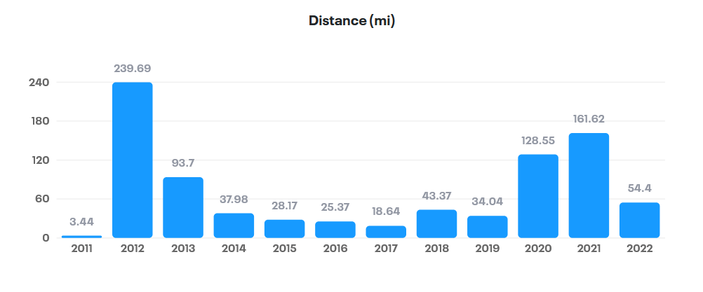
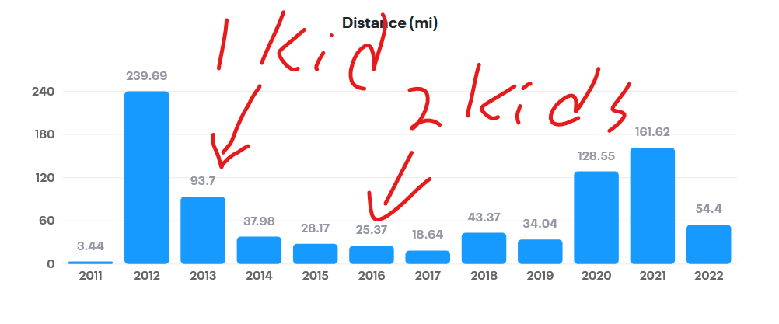
About Me
Jake Adams
Enterprise Architect
World Wide Technology
Twitter - @jacobladams
GitHub – github.com/jacobladams
Email – jacobladams@gmail.com

Slide 4

What is Pulumi?

Slide 5

WTF is ?
“Build, deploy, and manage modern cloud applications and infrastructure using familiar languages, tools, and engineering practices.” - Pulumi.com

Slide 6


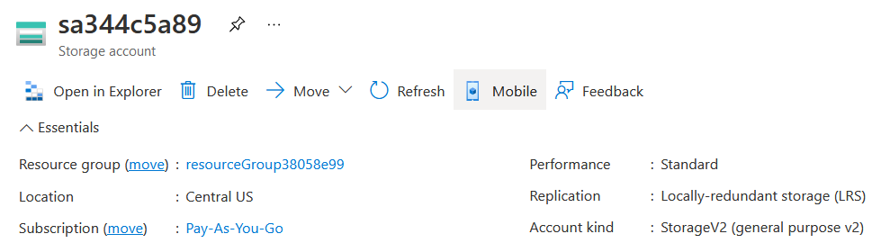
WTF is ?
var resourceGroup = new
ResourceGroup("resourceGroup");
var storageAccount =
new StorageAccount("sa",
new StorageAccountArgs
{
ResourceGroupName =
resourceGroup.Name,
Sku = new SkuArgs
{
Name = SkuName.Standard_LRS
},
Kind = Kind.StorageV2
});

Slide 7

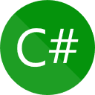








WTF is ?
Cloud Providers | Languages
And countless others

Slide 8

Why?

Slide 9
Why Infrastructure as Code
Code
Written documentation
Build reusable block, abstract away complex concepts
Source Control
History
Enable Collaboration
Change log
Automation
Repeatable , less error prone
Quicker
Have everything in case it's destroyed
Don’t have to worry as much about backups

Slide 10
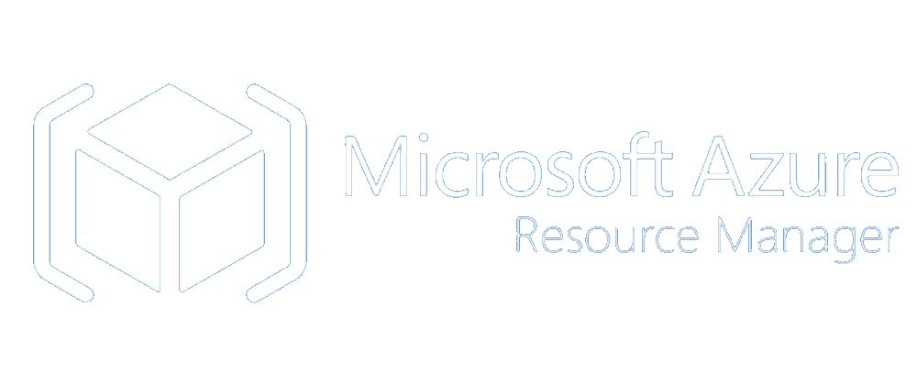





Comparison
 |  | Manual (ClickOps) |  | Azure CLI | Bicep
Repeatable
Declarative
Multi-cloud
General purpose language
Human readable

Slide 11
Tradeoffs
Defining your infrastructure in C# means … your infrastructure is defined in C#.
Smaller ecosystem
Delay in feature releases (Pulumi “native” packages)

Slide 12

DEMOS
He’s finally getting to the code!

Slide 13



Learn more / Questions
Pulumi.com
/learn
/docs
/registry
/resources

